Slide 1

EVENT TICKET BOOKING WITH QR CODE VALIDATION
👨‍💻S.RAVI 22221A05A1
👨‍💻N.H.S.SRIRAM 22221A0580
👨‍💻S.S.S.PRAVEEN 22221A05B0
👨‍💻P.VEERANNA 22221A0587
👨‍💻CH.S.KOPPESWARAO 23225A0502
TEAM MEMBERS
PROJECT SUPERVISOR
project guide
Mr. M.V.K.SUBASH
Mr. T.V.L.SRINIVASA RAO
M.Tech.,(Ph.D)
M.Tech.
Head of the department
Dr.MEERASHARIF SHEIK
M.Tech.,Ph.D
Academic Year: 2025–2026

Slide 2



Introduction
batch 09
Online event booking platform
Easy Ticket Booking
Reduces Manual Work &
Quick Confirmation
The online event booking platform allows users to browse available events, check ticket availability, and book tickets digitally. It eliminates the need for physical counters and provides convenient, anytime access to event information and booking services.
Easy ticket booking enables users to select events, choose tickets, and complete bookings through a simple interface. It reduces complexity, saves time, avoids confusion, and makes the entire booking process smooth and user friendly.
The system reduces manual work by automating ticket booking, payment processing, and record maintenance.
Quick confirmation provides users with instant booking status after successful payment. It delivers immediate ticket details.
2

Slide 3

Problem Statement
batch 09
Manual booking issues occur due to paper-based records and human involvement, causing slow processing, higher error chances, data loss, and difficulty managing bookings during peak demand.
01
Manual booking issues
Long queues arise in traditional booking systems where users wait physically for tickets, leading to time wastage, overcrowding, inconvenience, and poor customer experience during popular events.
02
Long queues
Payment problems occur due to cash handling, delayed confirmations, billing errors, lack of transaction proof, and difficulties in managing refunds within traditional or semi-digital booking systems.
03
Payment problems
Lack of real-time updates prevents users from viewing current ticket availability and booking status, leading to confusion, overbooking, cancellations, and inefficient event planning.
04
No real-time updates
3

Slide 4
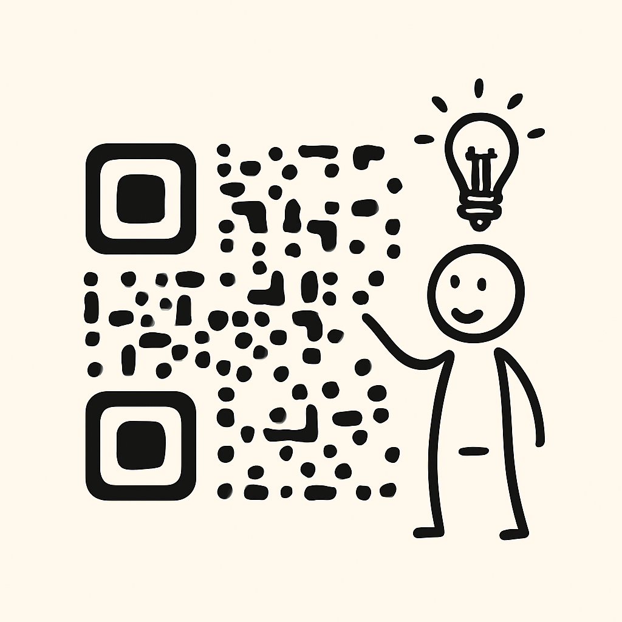
Objectives
batch 09
Automate booking process
Automating booking reduces manual work by digitally managing event selection, ticket reservation, and confirmation, improving speed, accuracy, and efficiency.
Enable online payments
Online payments allow users to complete transactions securely with instant confirmation, reducing cash handling issues and improving reliability and convenience.
Provide QR code validation
QR code validation ensures secure entry by verifying digital tickets quickly, preventing duplicate access, and enabling smooth event entry management.
Improve user experience
The system enhances user experience with a simple interface, fast booking process, instant confirmation, and easy access to event information.
Key Insight
Automating booking with secure online payments, QR-based validation, and a user-friendly interface streamlines event management by reducing manual effort while ensuring faster, safer, and more reliable user transactions.
4

Slide 5



Existing System
batch 09
Manual Ticket Booking
Long Waiting Time
Payment Handling Issues
In the existing system, ticket booking is handled manually at physical counters using paper records. This approach requires more human effort, increases paperwork, and consumes more time. Manual handling often leads to errors, misplaced records, and difficulty managing bookings during peak event demand.
Users are required to stand in long queues to purchase tickets in traditional systems. This causes inconvenience, wastes valuable time, and leads to overcrowding at ticket counters. During popular events, long waiting times reduce customer satisfaction and make the ticket booking experience stressful and inefficient.
Existing systems mostly rely on cash payments or basic transaction methods. This creates problems such as delayed payment confirmation, billing mistakes, lack of proper transaction records, and difficulty processing refunds. Payment handling issues reduce trust and make financial management difficult for event organizers.
5

Slide 6
Proposed System
batch 09
Online Ticket Booking System
Secure Payment and QR Validation
Real-Time Updates and Management
The proposed system allows users to browse events, check ticket availability, and book tickets online easily, eliminating manual processes and providing faster, more convenient access to event services.
The system supports secure online payments with instant confirmation and generates QR codes for tickets, ensuring safe transactions, preventing duplicate entry, and enabling smooth and secure event access.
The proposed system provides real-time updates on ticket availability, booking status, and event details, helping users and administrators manage events efficiently and reducing confusion or overbooking issues.
6

Slide 7
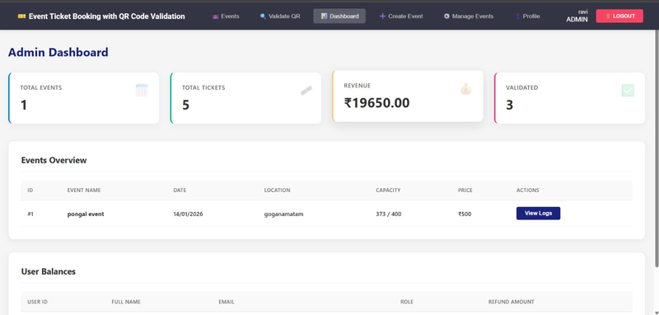
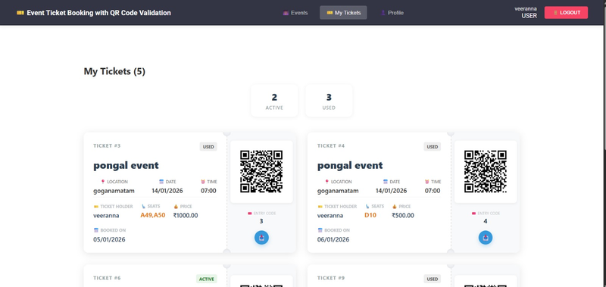
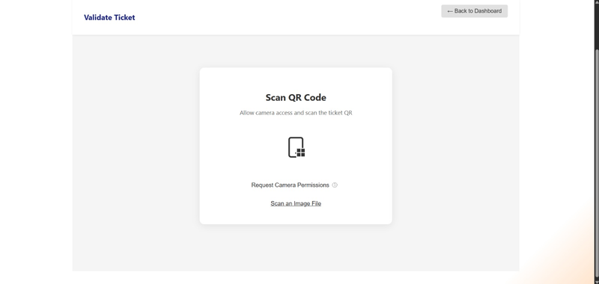
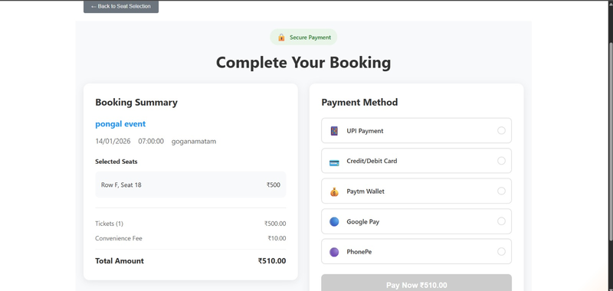
System Modules
batch 09
Admin Module
User Module
QR Code Validation Module
Payment Module
7

Slide 8





batch 09
TECHNOLOGY USED
Frontend: React
Database: MySQL
Backend: Spring Boot
Language: Java
8

Slide 9
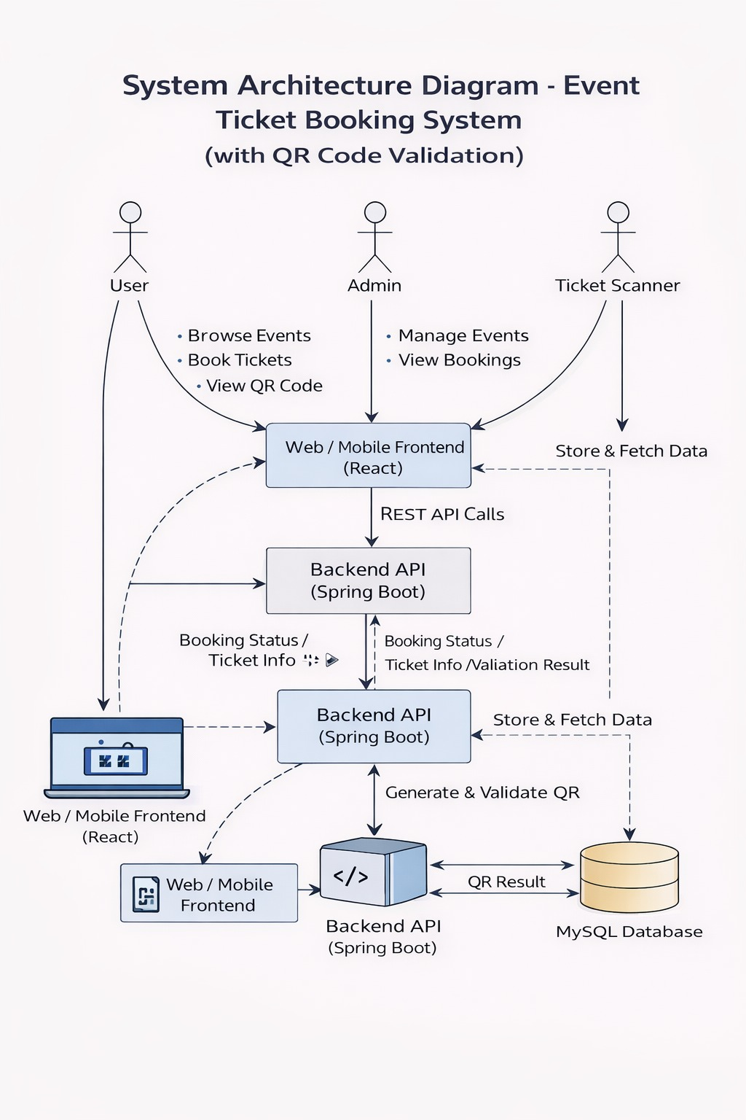
batch 09
System Architecture
• User interacts with web interface
• Frontend sends requests to backend
• Backend processes business logic
• Database stores user and booking data
• QR validation used at event entry
Key Features
• Online event ticket booking
• Secure online payment integration
• QR code–based ticket validation
• Real-time ticket availability
• User and admin role management
9

Slide 10
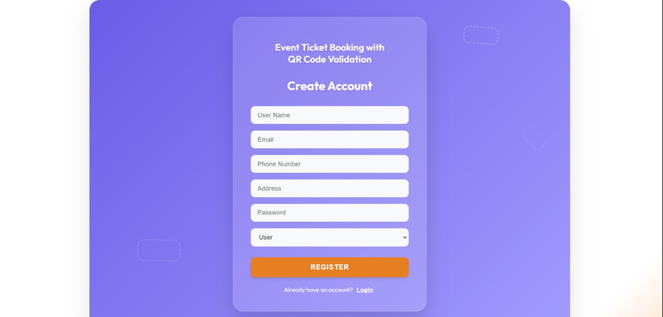
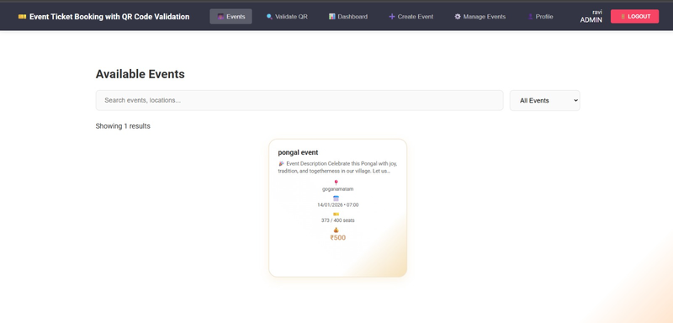
Output Screens
batch 09
User Login and Registration Screen
Event Listing Screen
Ticket Booking Screen
Payment Screen
QR Code Ticket Screen
Admin Dashboard Screen
10

Slide 11
Applications
batch 09
Enhances user convenience
Supports real-time data management
The system allows users to access services anytime and anywhere using internet-enabled devices.
Real-time updates help both users and organizers track bookings, payments, and availability instantly.
Reduces operational costs
Improves data security and reliability
Automation lowers operational expenses by reducing manpower, paperwork, and manual processing.
Digital storage ensures secure handling of user data and prevents data loss or duplication.
Scalable and flexible system
Improves overall system transparency
The application can handle an increasing number of users and can be easily updated with new features.
Clear transaction records and status updates improve trust and transparency between users and organizers.
11

Slide 12
Conclusion
batch 09
Efficient system
Secure and reliable
Easy to manage events
The system works efficiently by automating event ticket booking, payment processing, and QR code validation. It reduces manual intervention, speeds up operations, handles multiple users simultaneously, and ensures smooth performance even during high demand, improving overall system productivity.
The system is secure and reliable by implementing user authentication, secure online payment gateways, and QR code–based ticket verification. It protects user data, prevents unauthorized access, avoids duplicate ticket usage, and ensures consistent system performance without data loss or errors.
The system allows administrators to easily create, update, and manage events using a centralized dashboard. It simplifies tracking bookings, monitoring payments, handling refunds, and managing attendee entry, reducing operational complexity and making event management more organized and efficient.
12

Slide 13
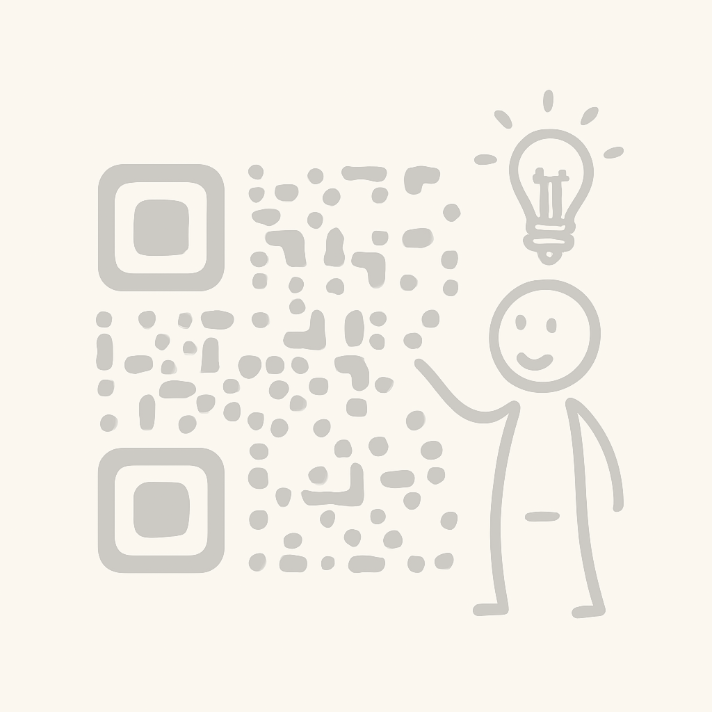
THANK
YOU

